Slide 1
Logical Tools and Theories in Contemporary Bioinformatics
Barry Smith
http://ontology.buffalo.edu/smith

Slide 2
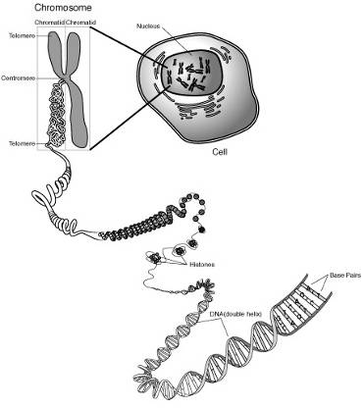
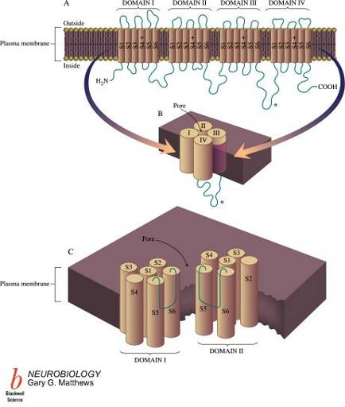
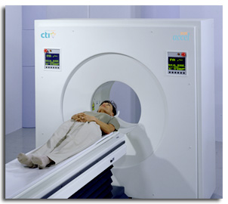
From
chromosome
to disease

Slide 3
genomics
proteomics
reactomics
metabonomics
phenomics
behavioromics
connectomics
toxicopharmacogenomics
… legacy of Human Genome Project

Slide 4
-omics data
biochemical disease pathway data
biomedical image data
electronic health record data
hospital management data
hospital insurance data
public health data
Chinese chicken data

Slide 5
Main obstacle to integrating genetic and EHR data
Poor facilities for dealing with time and instances (particulars) in current reasoning systems (OWL-DL, ...)

Slide 6
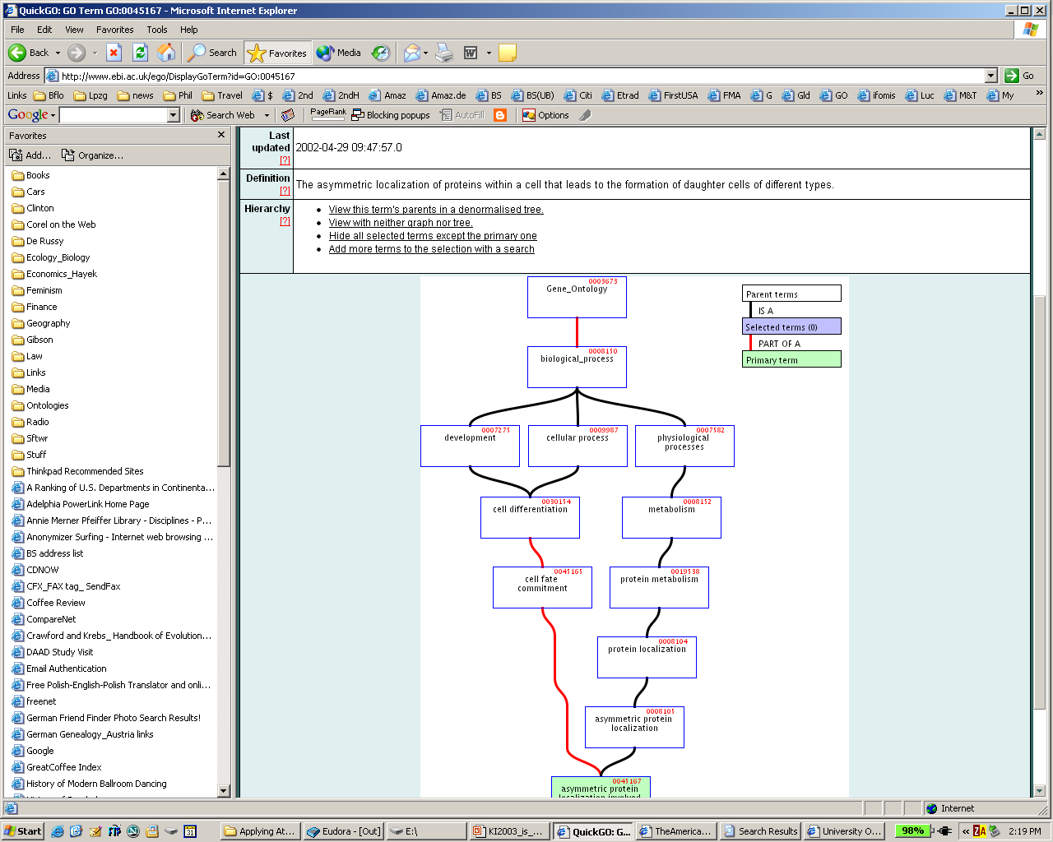
GO: asymmetric protein localization involved in cell fate commitment

Slide 7
A is_a B =def.
‘A’ is more specific in meaning than ‘B’
meningitis is_a disease of the nervous system
unicorn is_a one-horned mammal
Better:
every instance of A is an instance of B

Slide 9
A part_of B
in the old Gene Ontology has four alternative meanings:
All instances of A are part of some instance of B
Some instance of A is part of some instance of B
All instances of A are part of all instances of B
No relation at all is specified between A and B

Slide 10
How link ontologies together
if they each use different relations to link their terms in ad hoc and logically incoherent ways

Slide 11
RELATION TO TIME GRANULARITY | CONTINUANT |  |  |  | OCCURRENT
 | INDEPENDENT |  | DEPENDENT
ORGAN AND ORGANISM | Organism (NCBI Taxonomy) | Anatomical Entity (FMA, CARO) | Organ Function (FMP, CPRO) | Phenotypic Quality (PaTO) | Biological Process (GO)
CELL AND CELLULAR COMPONENT | Cell (CL) | Cellular Component (FMA, GO) | Cellular Function (GO)
MOLECULE | Molecule (ChEBI, SO, RnaO, PrO) |  | Molecular Function (GO) |  | Molecular Process (GO)
Open Biomedical Ontologies (OBO) Foundry

Slide 12
The OBO Relation Ontology
Genome Biology 2005, 6:R46
downloaded 20,000 times
based on the fundamental distinction between instances and universals

Slide 13
OBO Relation Ontology (RO)
Foundational | is_a part_of
Spatial | located_in contained_in adjacent_to
Temporal | transformation_of derives_from preceded_by
Participation | has_participant has_agent

Slide 14
Part_of as a relation between universals is more problematic than is standardly supposed
heart part_of human being ?
human heart part_of human being ?
human being has_part human testis ?
human testis part_of human being ?
human testis part_of adult human being ?

Slide 15
two kinds of parthood
between instances:
Mary’s heart part_of Mary
this nucleus part_of this cell
between universals
human heart part_of human
cell nucleus part_of cell

Slide 16
Definition of part_of as a relation between universals
A part_of B =Def. all instances of A are instance-level parts of some instance of B
human testis part_of adult human being
but not
adult human being has_part human testis

Slide 17
Fundamental Dichotomy
Continuants (aka endurants)
  have continuous existence in time
  preserve their identity through change
  exist in toto whenever they exist at all
Occurrents (aka processes)
  have temporal parts
  unfold themselves in successive phases
  exist only in their phases

Slide 18
part_of for processes
A part_of B =def.
For all x, if x instance_of A then there is some y, y instance_of B and x part_of y
where ‘part_of’ is the instance-level part relation
EVERY A IS PART OF SOME B

Slide 19
part_of for continuants
A part_of B =def.
For all x, t if x instance_of A at t then there is some y, y instance_of B at t and x part_of y at t
where ‘part_of’ is the instance-level part relation
ALL-SOME STRUCTURE

Slide 20
is_a (for processes)
A is_a B =def
For all x, if x instance_of A then x instance_of B
cell division is_a biological process

Slide 21
is_a (for continuants)
A is_a B =def
For all x, t if x instance_of A at t then x instance_of B at t
abnormal cell is_a cell
adult human is_a human
but not: adult is_a child

Slide 22
These definitions should support cross-ontology reasoning
Whichever A you choose, the instance of B of which it is a part will be included in some C, which will include as part also the A with which you began
The same principle applies to the other relations in the OBO-RO:
located_at, transformation_of, derived_from, adjacent_to, etc.

Slide 23
A part_of B, B part_of C ...
The all-some structure of the definitions in the OBO-RO allows
cascading of inferences
(i) within ontologies
(ii) between ontologies
(iii) between ontologies and EHR repositories of instance-data

Slide 24
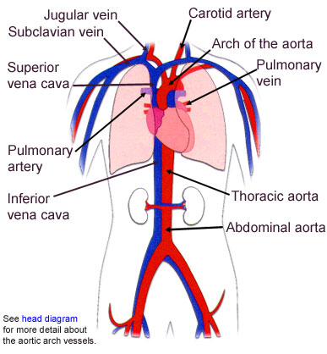
Continuity
Attachment
Adjacency

Slide 25
Physical discontinuity
vs.
Fiat boundary

Slide 26
Modes of Connection
Modes of connection:
  attached_to (muscle to bone)
  synapsed_with (nerve to nerve, nerve to muscle)
  continuous_with (= share a fiat boundary)

Slide 27
a continuous_with b
= a and b are continuant instances which share a fiat boundary
This relation is always symmetric at the instance level:
if x continuous_with y , then y continuous_with x

Slide 28
continuous_with
(relation between universals)
A continuous_with B =Def.
for every instance x of A
there is some instance y of B such that
x continuous_with y

Slide 29
continuous_with is not always symmetric
Consider lymph node and lymphatic vessel:
  Each lymph node is continuous with some lymphatic vessel, but there are lymphatic vessels (e.g. lymphs and lymphatic trunks) which are not continuous with any lymph nodes

Slide 30
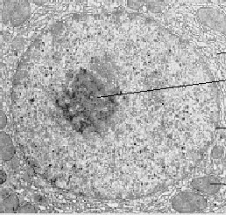
instance level
this nucleus is adjacent to this cytoplasm
implies:
this cytoplasm is adjacent to this nucleus
universal level
nucleus adjacent_to cytoplasm
Not: cytoplasm adjacent_to nucleus

Slide 31
Adjacent_to as a relation between universals is not symmetric
Consider
seminal vesicle adjacent_to urinary bladder
Not: urinary bladder adjacent_to seminal vesicle

Slide 32
Applications
Expectations of symmetry e.g. for protein-protein interactions may hold only at the instance level
if A interacts with B, it does not follow that B interacts with A
if A is expressed simultaneously with B, it does not follow that B is expressed simultaneously with A

Slide 33
transformation_of
A transformation_of B =Def.
Every instance of A was at some earlier time an instance of B
  adult transformation_of child

Slide 34
transformation_of
same instance
C
c at t
C₁
c at t₁
time
pre-RNA
mature RNA
child
adult

Slide 35
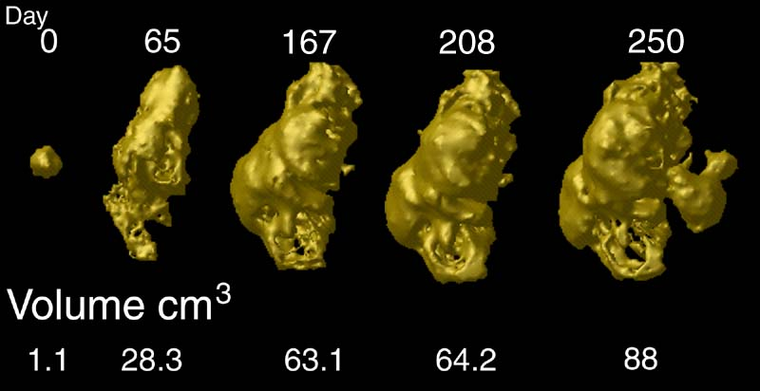
tumor development
C
c at t
C₁
c at t₁
Notes:
http://www.loni.ucla.edu/~thompson/HBM2000/tumor_volumes.jpg

Slide 36
derives_from
C
c at t
C₁
c₁ at t₁
time
C'
c' at t
instances
ovum
zygote derives_from
sperm

Slide 37
two continuants fuse to form a new continuant
C
c at t
C₁
c₁ at t₁
C'
c' at t
fusion

Slide 38
one initial continuant is replaced by two successor continuants
C
c at t
C₁
c₁ at t₁
C₂
c₂ at t₁
fission

Slide 39
one continuant detaches itself from an initial continuant, which itself continues to exist
C
c at t
c at t₁
C₁
c₁ at t
budding

Slide 40
one continuant absorbs a second continuant while itself continuing to exist
C
c at t
c at t₁
C'
c' at t
capture

Slide 41
New Relations in RO
lacks (between an instance and a universal, e.g. this fly lacks wings)
dependent_on (between a dependent entity and its carrier or bearer)
quality_of (between a dependent and an independent continuant)
functioning_of (between a process and an independent continuant)

Slide 42
Advantages of the methodology of enforcing commonly accepted coherent definitions
promote quality assurance (better coding)
guarantee automatic reasoning across ontologies and across data at different granularities
yields direct connection to times and instances in EHR

Slide 43
END

